Slide 1


Understanding the Role of Educators
Welcome to our exploration of the teaching profession, where we dive into the essence of what it means to be an educator. Teachers are the architects of knowledge, shaping the minds of future generations. In this presentation, we will detail the definition of a teacher, analyze the qualities that exemplify an outstanding educator, examine the influence of teacher behavior, and underscore the profound impact teachers have on their students.
sa
by sk pc

Slide 2
The Definition of a Teacher
A teacher is more than just an individual who imparts knowledge. They are mentors, guides, and leaders who navigate the educational journey with their students. A teacher's role encompasses a spectrum of responsibilities, from creating lesson plans to assessing student performance, fostering a positive learning environment, and encouraging lifelong learning.
Educator
Mentor
Innovator
One who imparts knowledge across various subjects, ensuring students gain the necessary skills to succeed academically.
A guide who provides support, inspiration, and encouragement for personal and professional growth.
An educator adept at incorporating new teaching strategies and technologies to enhance learning.

Slide 3

Qualities of a Good Teacher
A good teacher possesses characteristics that transcend academic knowledge. Patience, adaptability, and empathy are foundational qualities. They possess an unwavering commitment to their students' success and well-being, which is evidenced through their dedication and perseverance.
1
Patience
2
Expertise
Exhibits tolerance and understanding, creating a stress-free learning environment for students.
Maintains a deep understanding of the subject matter to provide high-quality education.
3
Communication
4
Enthusiasm
Effectively conveys ideas in a clear, concise manner, enabling students to grasp complex concepts.
Demonstrates passion for teaching, inspiring students to develop a love for learning.

Slide 4
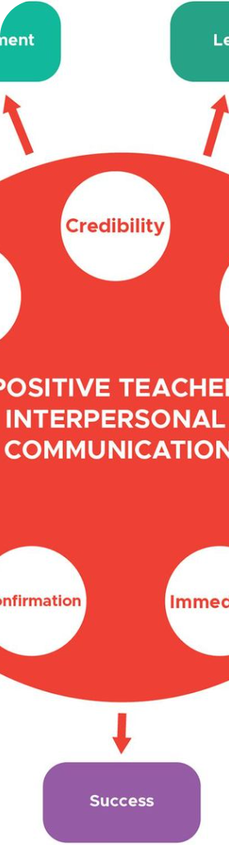



Importance of Teacher Behavior
Teacher behavior sets the tone for the classroom environment. It's a key determinant of student engagement and academic success. The manner in which a teacher interacts with students influences their motivation, self-esteem, and respect for both peers and authority.
Engagement
Positive behavior leads to a more engaged and active classroom, promoting better learning outcomes.
Modeling
Teachers act as role models; their actions teach students about social dynamics and professional conduct.
Encouragement
Reinforcing good behavior and efforts can build student confidence and a positive classroom culture.

Slide 5
Positive Behaviors of a Good Teacher
A superb teacher consistently demonstrates behaviors that uplift and advance the learning process. They foster curiosity, provide constructive feedback, and adapt to the individual needs of their students, nurturing an environment where every student feels valued.
Encouragement
Adaptability
Accessibility
Offering praise and recognition for student efforts and achievements.
Modifying teaching methods to suit different learning styles and needs.
Being approachable and available to assist students outside of class time.

Slide 6
Negative Behaviors to Avoid as a Teacher
Awareness of negative behaviors is crucial for educators, as their actions can inadvertently undermine student confidence and enthusiasm for learning. Teachers must be vigilant to avoid biases, discourage negative criticism, and prevent any semblance of favoritism.
1
Impatience
Rushing through explanations or expressing frustration with student questions can create anxiety and hinder learning.
2
Indifference
Failing to recognize or address student needs and concerns may lead to disengagement.
3
Intolerance
Not respecting diverse perspectives and backgrounds can create a hostile environment.

Slide 7
Impact of Teacher Behavior on Students
The ripple effects of a teacher's behavior are felt throughout a student's educational journey. Positive reinforcement can elevate a student's trajectory, while negative interactions can leave lasting scars, affecting attitudes towards learning far into the future.
Positive Behaviors
Negative Behaviors
Inspires confidence and resilience
May cause self-doubt and anxiety
Encourages collaboration and respect
Can result in isolation and conflict
Boosts motivation and ambition
Contributes to apathy and disengagement

Slide 8

Conclusion and Key Takeaways
In summary, a teacher's influence extends far beyond the classroom walls. The essence of good teaching encompasses a blend of knowledge, compassion, and integrity. Through their dedication, teachers ignite curiosity, foster talent, and pave pathways to success for their students.
1
Inspirational Role
2
Behavioral Impact
Teachers can inspire a lifelong love of learning and personal growth through their dedication and passion.
The behavior of educators is pivotal in shaping student experiences and perspectives on education.
3
Empathy and Support
Understanding and supporting the emotional needs of students is just as important as academic guidance.

Slide 9



Enhancing Learning through Examples
Interactive learning and real-world examples make education come alive. By integrating hands-on activities and relatable scenarios, teachers can create an immersive learning experience that resonates with students and deepens their understanding.
Critical Thinking
Experimentation
Global Context
Using puzzles and problem-solving exercises to enhance logic and reasoning skills.
Conducting hands-on experiments to explore scientific principles and encourage inquiry.
Incorporating global issues and perspectives to promote cultural awareness and empathy.

Slide 10
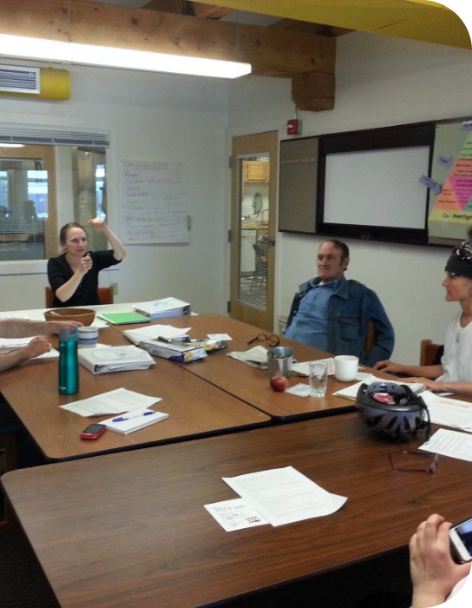

Thank You
We appreciate your attention and hope that this presentation has provided valuable insights into the teaching profession. If there are any questions or further topics you would like to discuss, please feel free to ask. Our goal is to support a collaborative journey in education.

